Slide 1
CMPH-200
Microprocessors 3
Buses, Addresses and Machine Cycles
November 2000
©Paul R. Godin
and SAIT

Slide 2
Logic and Flip-Flops
The microcomputer is, above all, a logic device. Standard logic gates and flip-flops are commonly used, including:
  Inverters
  AND, NAND and OR gates
  JK and D flip-flops
  Tri-state buffers
  Most devices are from the TTL-LS family.
How many different logic gates and flip-flops can you identify from the circuit diagram?

Slide 3
Buses
There are three main buses on any computer system:
  Address bus: Carries destination information for data.
  Data bus: Carries program instructions or data.
  Control bus: Responsible for the overall control and synchronization of the computer system.

Slide 4
Buffering
System buses are susceptible to noise and other signal degradation. Active buffers help condition signals present on a bus.
Some of the commonly used buffers used with the 8085 include:
  74LS273 (Octal D FF, positive edge)
  74LS175 (Hex D FF, pos edge)

Slide 5
Buffer/Drivers
In microcomputer systems, when an external connection is required, a buffer/driver may be used to condition and isolate the buses.
With the 8085 μP, the 81LS95 is used for external bus connections.

Slide 6
Data Bus
The data bus is bi-directional and is responsible for transporting data between the μP and the peripheral devices.
The 8085 has an 8 bit data bus.

Slide 7
Address Bus
The address bus identifies the location of the peripheral device or memory location.
The 8085 has a 16-bit address bus that is capable of handling 2¹⁶ addresses (65,536, rounded off to 64k).
Address buses are unidirectional. The bits flow from the MPU to the devices.

Slide 8
Multiplexing
Multiplexing is defined as utilizing a bus for several functions.
The 8085 has a multiplexed address bus:
  The first 8 address bits, or lower address, (AD₀ to AD₇) are multiplexed, and are alternately used for address and data bits. This half of the address bus is bi-directional.
  The upper address bus, or high-order addresses (A₈ to A₁₅), are not multiplexed and are unidirectional.

Slide 9
Demultiplexing
A demultiplexeing system is used to separate the address output from the data output of the lower 8 bit AD bus.
An 8-bit register is able to latch onto the address byte provided to it.
Typically, the 74LS374 is used. This device’s input is enabled when the address is presented on the multiplexed bus, allowing it to latch onto the lower order address. The ALE input provides the enabling edge.
Look up the 74LS374 and see how it operates.

Slide 10
Address Decoders
A decoder converts a binary value to an active output.
The active output provides an enable to the device to which the address points to.
With the 8085, the 74LS138 (3 to 8 decoder) is used. This device receives a 3-bit address from A₁₂ to A₁₅ and provides an active-low on one of its 8 outputs.
This active output enables one of the I/O devices.
Look up the 74LS138 and see how it operates.

Slide 11
Address Decoding
The 74138:
  Determine the address range to enable each of the devices.
    ROM
    RAM
    Etc…

Slide 12
Input/Output
Input/output devices (I/O) are devices that supply data, or receive processed data from the computer system.
Input devices include: keyboards, mouse, sensors, switches, scanners, or any other information we may need to provide to the computer.
Output devices include: printers, monitors, displays, lights, motors, speakers. or anything else that the computer is controlling.

Slide 13
Input/Output
Typically, the computer is selected based on the degree of input or output information it must handle.
The I/O block is the interface between the computer’s internal circuitry and the external devices. These I/O devices are responsible for holding the data until the device or computer is ready to retrieve the information.
More information on I/O’s will be provided at a later time...

Slide 14
Timing Diagrams

Slide 15

Timing Diagrams
Timing diagrams in microprocessor systems are a little different from traditional digital timing diagrams.
There are many, many more combinations of inputs and outputs, therefore the individual lines that make up the data bus are not usually included in the timing diagram.
Combined lines are indicated with a

Slide 16
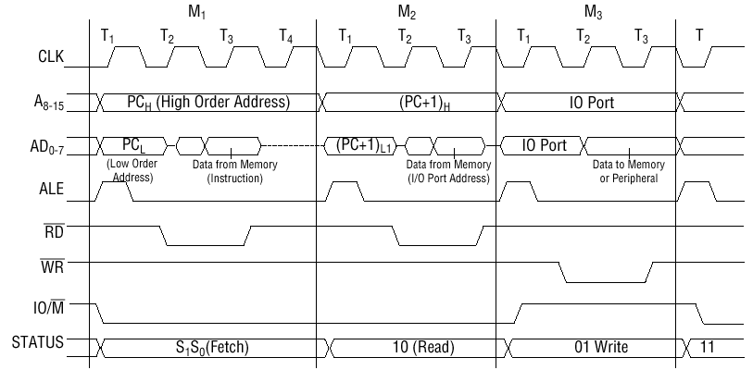
Machine Cycles
Microprocessors follow a pattern when fetching and executing instructions and performing read and write processes. These patterns are called machine cycles and are usually identified by M₁, M₂, etc … .

Slide 17
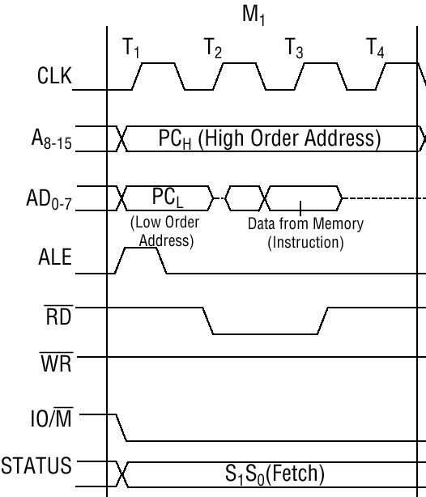
M₁: Opcode Fetch Cycle
The first cycle we will look at is the Fetch cycle, or M₁.

Slide 18
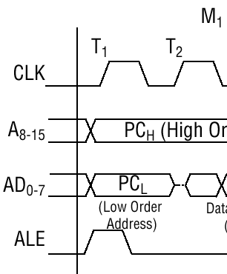
M₁ T₁
At M₁ T₁, the first clock pulse indicates that the lower multiplexed address/data bus is providing an address.
ALE goes high, then provides a negative edge in the middle of the cycle to indicate to the 74LS374 to latch on to that address.

Slide 19
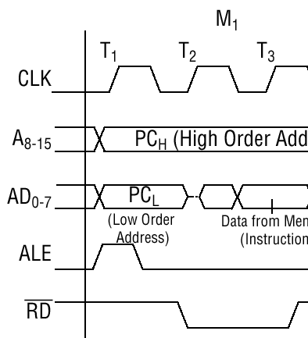
M₁ T₂
At M₁ T₂, the lower address has already been latched. The read (RD’) is active and the instruction is placed on AD₀ to AD₇.

Slide 20
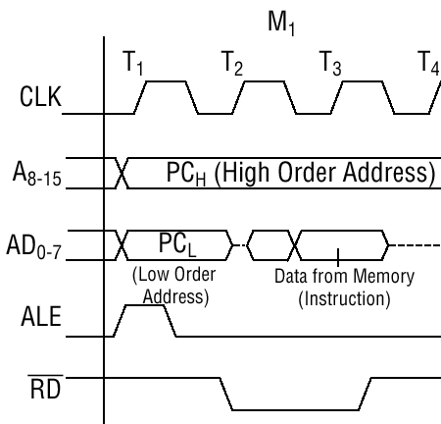
M₁ T₃
At M₁ T₃, the instruction from memory is on AD₀ to AD₇ and is read into the microprocessor’s register.

Slide 21
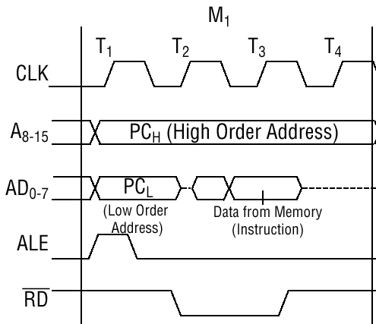
M₁ T₄
At M₁ T₄, the instruction is processed by the microprocessor and the AD₀ to AD₇ are in a high impedance state.

Slide 22
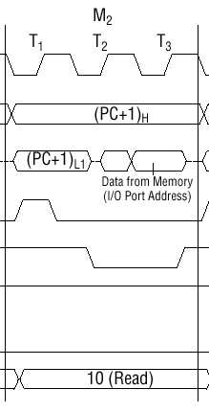
M_{2:} Memory Read Cycle
The second cycle to discuss is the memory read cycle.

Slide 23
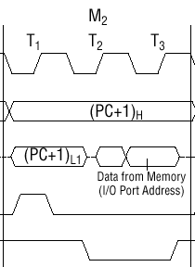

M₂ T₁
Just prior to M₂ T₁, the Program Counter increments the address by 1 (PC+1). The lower address bus is latched by ALE.

Slide 24
M₂ T₂
At M₂ T₂, the read is active (RD’). On the rising edge of T₂ the data bus is now an input bus to the 8085.

Slide 25
M₂ T₃
At M₂ T₃, the 8085 reads and stores the byte in the ACC register.

Slide 26
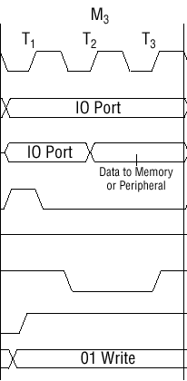

M_{3:} Memory Write Cycle
The memory write cycle is required to provide processed data from the microprocessor to either the memory or I/O devices.

Slide 27
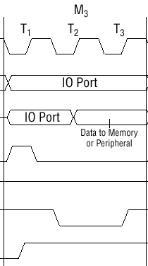

M₃ T₁
At M₃ T₁, the 8085 provides the IO address. The lower order address is latched by the falling ALE edge.
Note the address bits A₀ to A₉ or A₁₀ are connected to the I/O or memory device. The addresses A₁₁ to A₁₅ must be decoded by the 74LS138.
The status goes high to indicate this is an I/O operation.

Slide 28
M₃ T₂
At M₃ T₂, the write has been enabled and the decoder has enabled the proper I/O IC to read the data that is now on the AD bus.

Slide 29
M₃ T₃
At M₃ T₃, the active-low write is disabled and the microprocessor is ready for the next instruction.

Slide 30
End of Part 3
November 2000
©Paul R. Godin
All Rights Reserved
godin@tcel.com
6H

